Slide 1

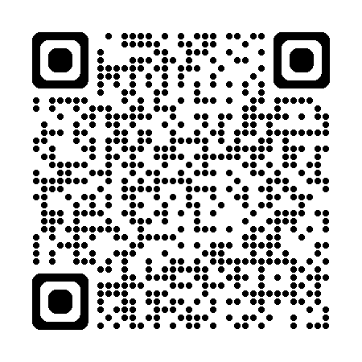
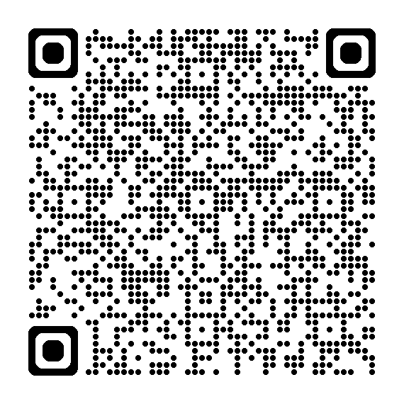
SoWhoCaresAnyway Podcast Link and QR code
SoWhoCaresAnyway
Your Episode Link & QR code
SoWhoCaresAnyway
Given wings to create ripple effects

