Slide 1


Championing Good People Practices
21 July 2025
Laura Rivet
HR Consultant and Associate with Rebekah Giffney Consulting

Slide 2

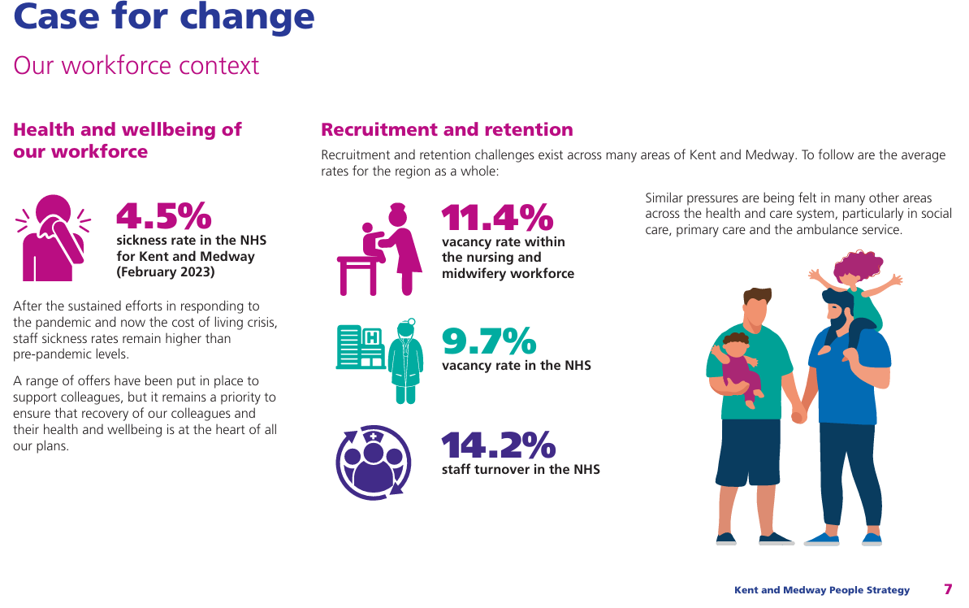

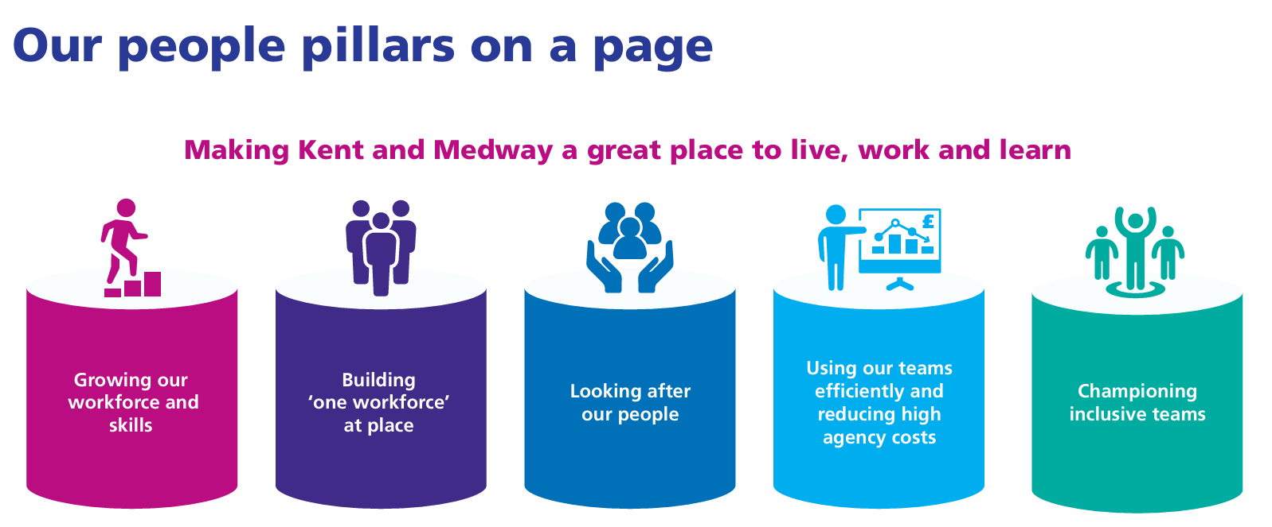


Slide 3
Today’s session will cover
Laying foundations
Setting expectations
Next steps and beyond
Job roles and descriptions
Recruitment
Induction
Probationary periods
Contracts of employment
Managing personal data
Line manager/employee 1:1s
Policies and procedures
Performance management
Appraisals/annual reviews
Values and behaviours
HR strategy and workforce planning

Slide 4

Equality, diversity and inclusion
Seven tips for workplace equality and diversity
  Identify and prevent unconscious bias
  Create equality, diversity and inclusion policies
  Mind your language
  Use objective criteria
  Be proactive
  Get advice if needed
  Watch out for indirect discrimination

Slide 5

Laying foundations

Slide 6

Job roles and descriptions
Laying foundations
  Defining the role and responsibilities
  Setting objectives and KPIs
  Linking role evaluation to pay

Slide 7

Recruitment
Laying foundations
Recruitment checklist
  Plan
  Prepare
  Advertise
  Handle applications
  Complete final details

Slide 8




Recruitment
Laying foundations
How to become a good interviewer
  Prepare well
  Be methodical
  Show you care
  Improve your judgement
  Preparation, communication, assessment

Slide 9
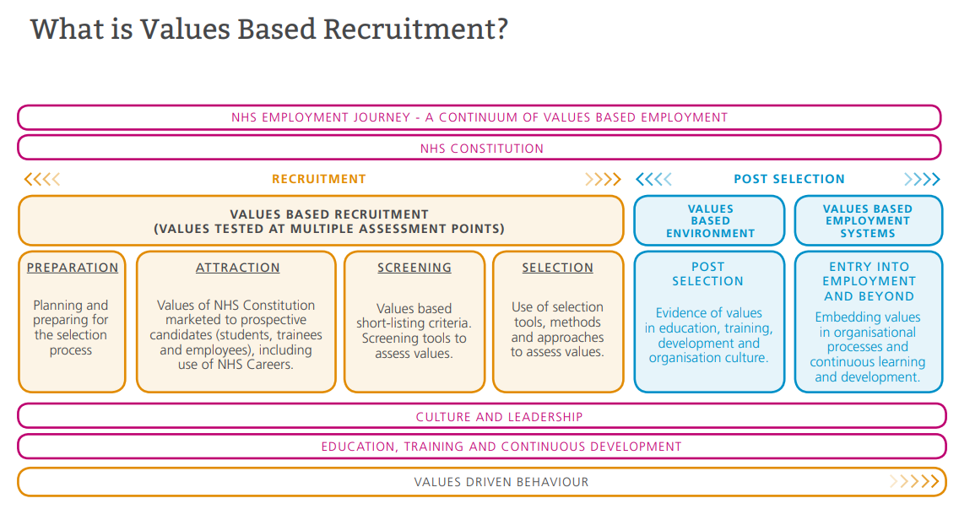
Recruitment
Laying foundations
Health Education England – Values Based Recruitment

Slide 10
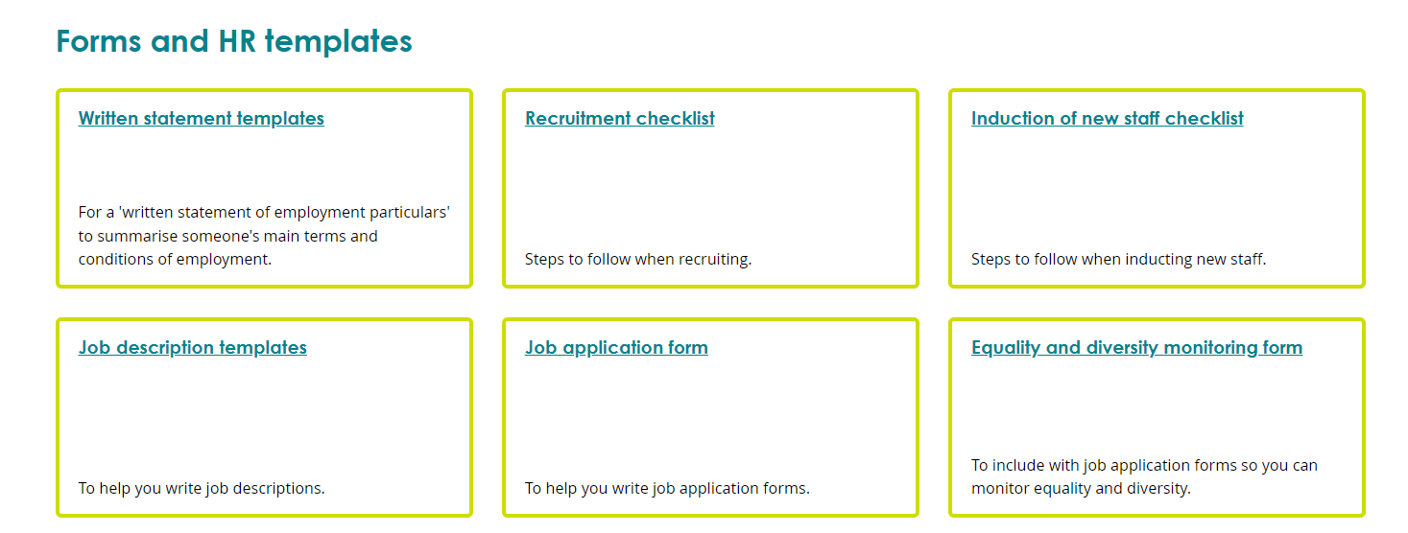
Recruitment
Laying foundations
Templates – ACAS templates

Slide 11

Recruitment poll – Mentimeter
Laying foundations
What is the most challenging aspect of recruitment?
Which platform is the most effective in attracting quality candidates?

Slide 12


Induction
Laying foundations
Induction checklist
  First day – first impression, welcome
  First week
  First month
  First 3/6/12 months

Slide 13

Probationary periods
Laying foundations
  Two-way approach
  Assessing suitability in the first
  3-6 months
  Opportunity for regular feedback
  Address issues early on
  Can be extended
What do you have in place?

Slide 14

Contracts of employment
Laying foundations
  Legal compliance
  Clear and concise language
  Essential contract elements

Slide 15
Managing personnel data
Laying foundations
  Required to have a data protection policy in place
  A named person responsible for the processing of data within the business
  GDPR compliant
Lawful basis
Data minimisation and purpose limitation
Individual rights
Data security and confidentiality
Data transfers and third party processing

Slide 16
HR systems
Laying foundations
What system do you use to manage HR data?
Streamlined
HR processes
Efficient data management
Employee
self service
Reporting
and analytics
Compliance with employment law

Slide 17
Taking stock - Mentimeter
Laying foundations
Where do you feel your workplace is with the areas discussed so far?
1 – nothing in place
10 – everything in place

Slide 18

Setting expectations

Slide 19

Line manager and employee relationship
Setting expectations
  One-to-one meetings
  Relationship building
  Expectation setting

Slide 20

Line manager and employee relationship
Setting expectations
What sort of manager are you?
  The empath
  The fire extinguisher
  The hype person

Slide 21
Policies and procedures/employee handbook
Setting expectations
Important to be:
  Up to date
  Legally compliant
  Integrated
  Accessible
Minimum topics:
Disciplinary
Grievance
Holiday
and leave
Absence performance
Flexible working
Family-friendly policies
Equal opportunities and equality, diversity and inclusion

Slide 22

Performance improvement
Setting expectations
  Measure performance regularly
  Not going to plan?
  Performance improvement plan (PIP)

Slide 23
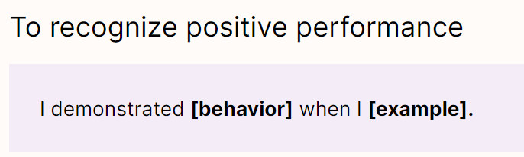
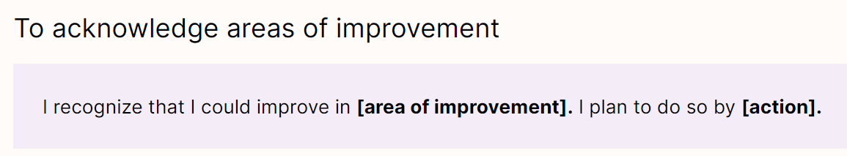
Performance review phrases to use – self-reflections
  Situation-Behaviour-Impact (SBI) model
  Situation: describe the situation, be specific
  Behaviour: describe the observable behaviour, avoid judgements
  Impact: explain how other are affected positively and negatively

Slide 24
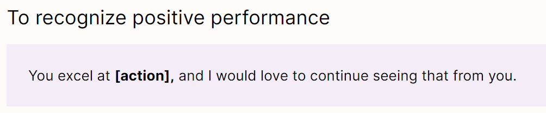
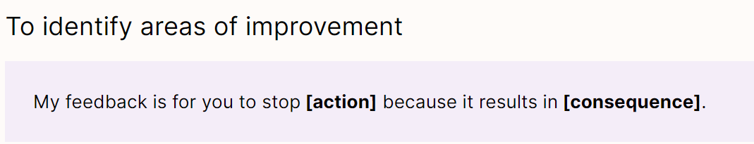
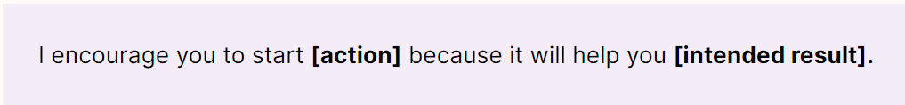
Performance review phrases to use – when you’re a manager
  STOP
  START
  KEEP DOING

Slide 25
Breaktime / Discussion point
Setting expectations
What are your key or current challenges associated with managing staff?

Slide 26

Next steps and beyond

Slide 27

Appraisal, performance reviews, PDRs
Next steps and beyond
  Feedback and recognition
  Goal alignment and clarity
  Development and growth
  Performance improvement

Slide 28

HR strategy and workforce planning
Next steps and beyond
Why?
  Alignment with business objectives
  Recruitment and retention
  Adapting to changing business or system needs
  Employee engagement and productivity
How?
  Succession planning
  Organisational culture and values

Slide 29

Values and behaviours
Next steps and beyond
Why?
  Clear direction and purpose
  Culture alignment
  Ethical and consistent decision-making
  Positive workplace culture
  Brand reputation
  Employee engagement and retention

Slide 30
Mentimeter poll
Of the areas just discussed under ‘next steps and beyond’, what would be the next priority?
What topics do you want to know more on?

Slide 31

Thank you for listening and taking part
Laura Rivet HR Consultant
and Associate with Rebekah Giffney Consulting

Slide 32
Resources
Laying foundations
Setting expectations
Next steps and beyond
Recruitment checklist
Job description template
Objective setting template
ACAS booklet on job evaluation
NHS job evaluation scheme
How to become a good interviewer
Health Education England NHS values based recruitment
ACAS templates for employers
ACAS induction checklist
A guide to 1-1 meetings
Redefining the manager
Performance improvement plan
Absence policy template
  Imperial College Values and Behaviours
  NHS employers VBR framework

